Slide 1
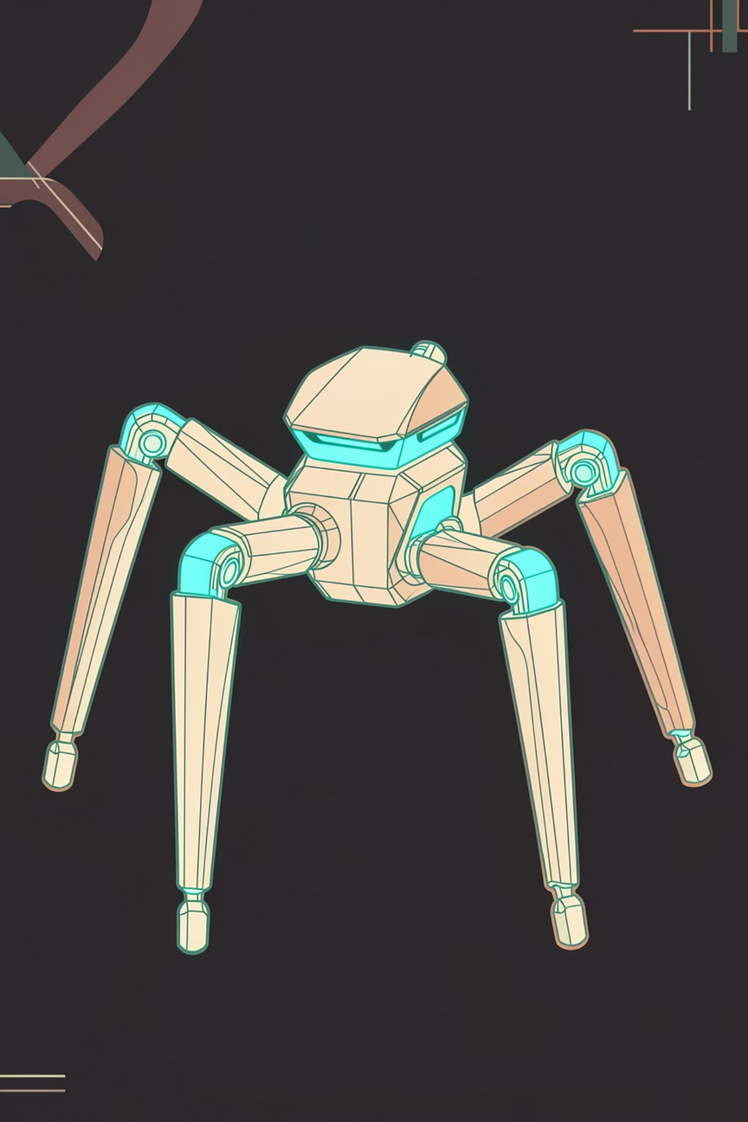

Relational Bias for Morphological Generalization in Robotic Control Using Graph Neural Networks
B.Tech Seminar · School of Computer Science & Engineering, MIT-WPU
Chaitanya Parate · PRN: 1032230750

Slide 2
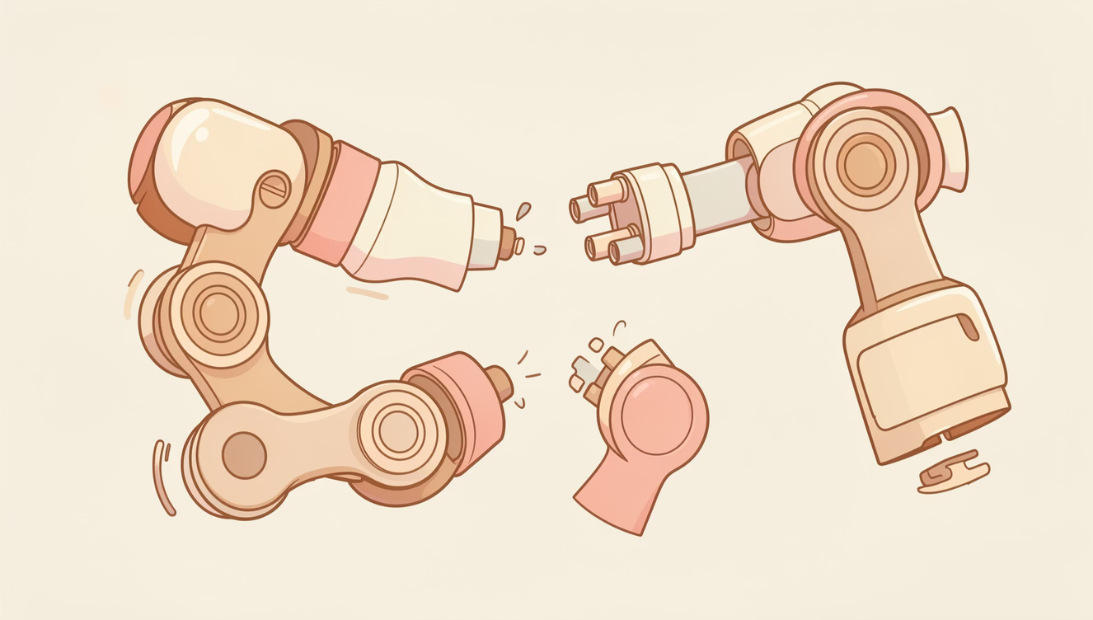

THE CORE PROBLEM
The "Rigidity" Problem: Why MLP Policies Fail
Traditional MLP policies flatten the robot's state into a fixed-size vector. This creates a hard architectural lock:
A 12-joint quadruped policy cannot control an 18-joint hexapod
Every new morphology demands full retraining from scratch
MLPs are blind to kinematic structure — they see joints as independent scalars
No weight-sharing across symmetric limbs → parameter bloat
MLP policies are morphology-locked. They learn one robot, not locomotion.

Slide 3



THE BREAKTHROUGH
Morphological Inductive Bias: The Robot as a Graph
Instead of a flat vector, we encode the robot as a Graph G = (V, E) — preserving its physical structure as a first-class input.
Nodes (V)
Edges (E)
Relational Bias
Each joint — HAA, HFE, KFE — becomes a typed node with proprioceptive state (angle, velocity, torque).
Kinematic links between joints encode physical adjacency and force propagation pathways.
The GNN learns how joints relate, not just what they are — enabling cross-morphology generalization.

Slide 4
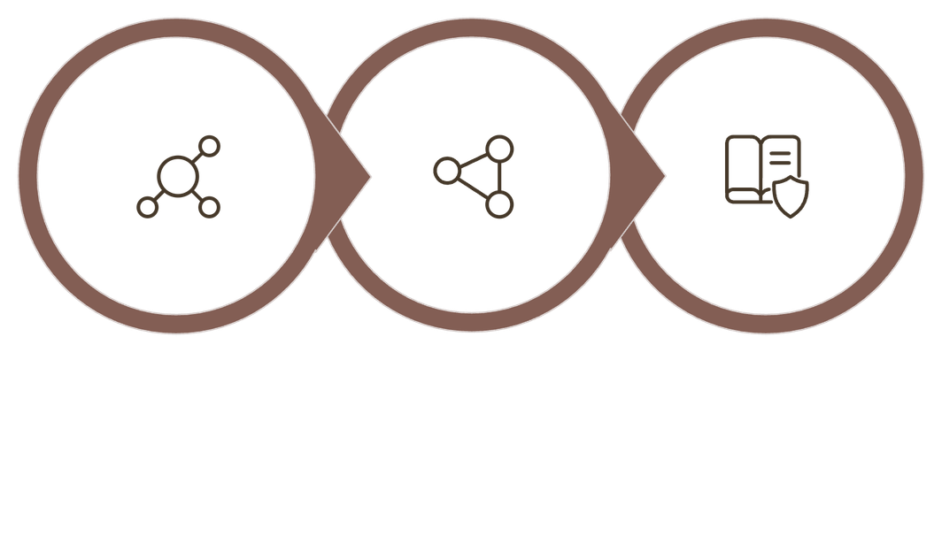
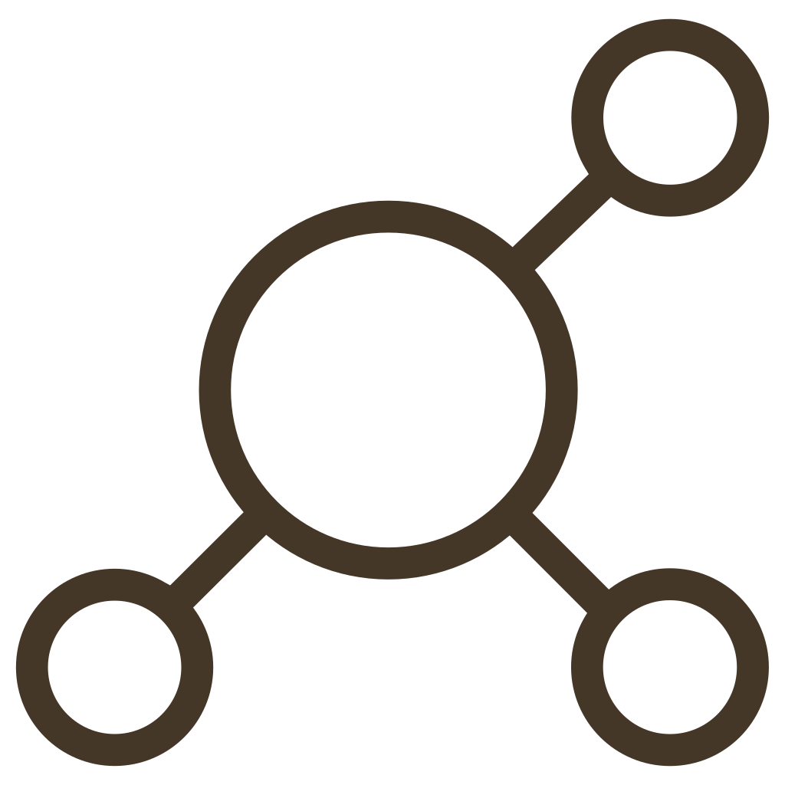
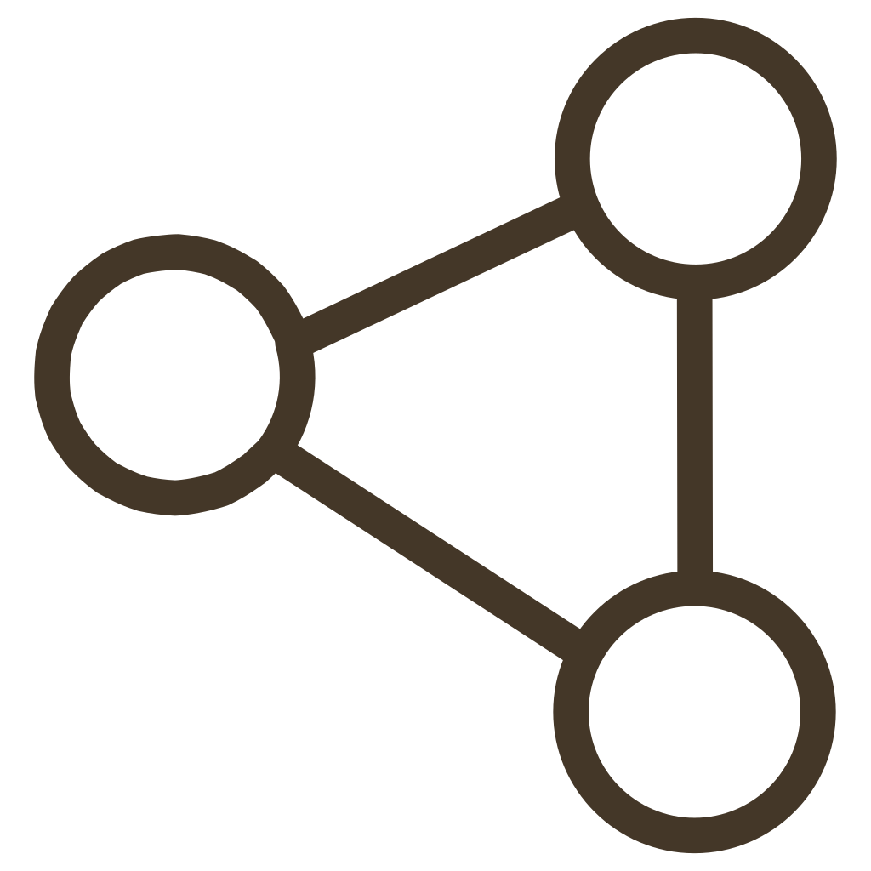

SYSTEM ARCHITECTURE
SlimHeteroGNN: Architecture Deep Dive
Heterogeneous Encoding
GATv2 Message Passing
Policy Head Output
The SlimHeteroGNN pipeline processes proprioceptive inputs through three stages — heterogeneous encoding, dynamic attention-based message passing, and policy head output — to generate torque commands for each joint.
Heterogeneous Node Types
GATv2 Attention Mechanism
85% Parameter Reduction
HAA, HFE, KFE joints share weights within type — enforcing mechanical symmetry and reducing redundant parameters.
Dynamic attention scores allow each joint to selectively attend to the most relevant neighbors at every timestep.
29,572 parameters vs. ~200,000 in an equivalent MLP — same performance, fraction of the compute.

Slide 5

LITERATURE REVIEW
Prior Work & Research Positioning
Authors & Year
Paper Title
What We Learned
Hwangbo et al. (2019)
Learning Agile Motor Skills for Legged Robots — Science Robotics
MLP policies transfer sim-to-real but are locked to one morphology.
Wang et al. (2018)
NerveNet: Learning Structured Policy with GNNs — ICLR
Graph structures enable transfer between robots with different limb counts.
Brody et al. (2021)
How Attentive are Graph Attention Networks? (GATv2) — ICLR
Dynamic attention outperforms static for modeling joint-to-joint interactions.
Butterfield et al. (2024)
Morphology-Informed Heterogeneous GNNs — ICRA
Heterogeneous node roles (HAA, HFE, KFE) enforce symmetry and improve efficiency.
Schulman et al. (2017)
Proximal Policy Optimization Algorithms — arXiv
PPO provides stability for training high-dimensional continuous locomotion.
Research Gap: No existing work combines heterogeneous GATv2 architectures with end-to-end PPO training to achieve zero-shot morphology transfer from quadrupeds to 18-joint hexapods.

Slide 6
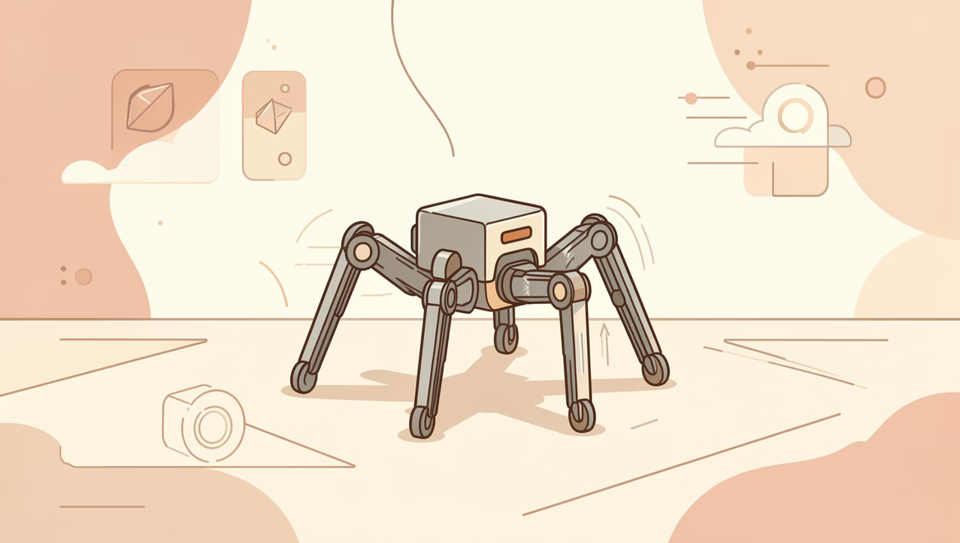
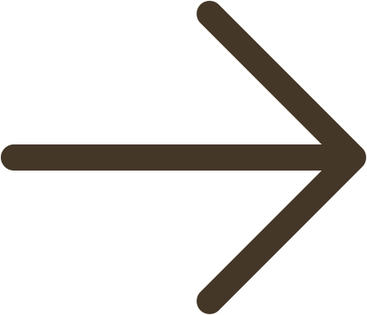
TRAINING PIPELINE
The Training Journey: PPO in PyBullet
Proximal Policy Optimization (PPO)
On-policy RL with clipped surrogate objective — stable gradients for high-dimensional continuous control.
Reward Engineering: Closing Exploits
"Couch Potato" Fix: Penalized zero-motion — robot must move forward to earn reward.
"Crawl" Fix: Added gait symmetry bonus — rewarded coordinated leg phasing.
Energy Penalty: Torque-squared cost enforced efficient, natural locomotion.

Slide 7
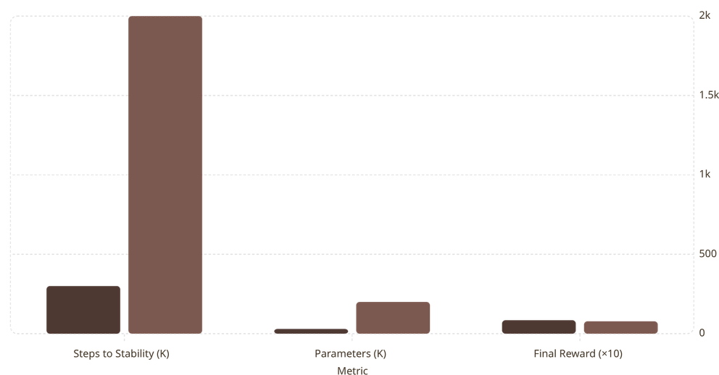
RESULTS
Performance Comparison: GNN vs. MLP
SlimHeteroGNN
MLP Baseline
Key Findings
2k
6.7× Faster Convergence
85% Fewer Parameters
GNN stabilizes at 300K steps vs. 2M for MLP — relational bias accelerates learning.
29,572 vs. ~200,000 — same reward with a fraction of the model size.
300
200
85
78
30
Superior Generalization
Only GNN transfers zero-shot to unseen morphologies. MLP fails completely.

Slide 8

ZERO-SHOT TRANSFER
The "Wow" Result: Quadruped → Hexapod, Zero Retraining
A policy trained exclusively on the 12-joint ANYmal quadruped successfully controls an 18-joint hexapod — with zero gradient updates.
Algorithmic Padding
Graph Permutation Equivariance
Extra hexapod joints are padded with null proprioceptive signals. The GNN's attention mechanism learns to ignore inactive nodes.
GNNs are inherently size-agnostic — the same message-passing function applies regardless of graph cardinality.
Morphological Continuity
Both robots share HAA/HFE/KFE joint taxonomy — the heterogeneous encoding transfers directly without adaptation.

Slide 9

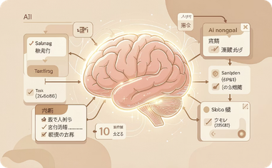

DEPLOYMENT STACK
Full-Stack Deployment: ROS2 Jazzy Pipeline
Vision Layer — YOLOv8
Intelligence Layer — Ollama (Qwen 2.5)
Simulation Layer — Gazebo Harmonic
Real-time object detection feeding spatial coordinates into the planning stack. 30 FPS on edge GPU.
LLM-based task decomposition: natural language commands → structured locomotion sub-goals via chain-of-thought prompting.
ROS2 Jazzy-native simulation with high-fidelity physics and sensor plugins for sim-to-real domain randomization.

Slide 10
CONCLUSION & FUTURE WORK
Summary & The Road Ahead
Core Contributions
Future Directions
SlimHeteroGNN with heterogeneous GATv2 attention
85% parameter reduction vs. MLP baseline
6.7× faster convergence (300K vs. 2M steps)
First zero-shot quadruped → hexapod transfer via graph padding
1
Sim-to-Real Transfer
Domain randomization and hardware-in-the-loop testing on physical quadruped platforms.
2
Multi-Agent Coordination
Extend GNN to model inter-robot communication graphs for emergent swarm locomotion.
3
Adaptive Morphology
Enable online graph restructuring for modular, reconfigurable robots.

